Slide 1
Review Sheet
Go through and answer all the questions on your own time.
Do not wait until the last minute to do this assignment.
Use your ppt. notes, yellow packet and pink packet to complete this.
Bring this the day of the review.
If you have this 90% done you may ask questions.
Cut up your review sheet to make flash cards!

Slide 2
If it is dark outside, what is a likely shutter speed?
Why?

Slide 3
If it is really sunny outside, what aperture would I use?
Why?
Is that a large or small opening

Slide 4
If a negative is in your enlarger… and it is not yours… what should you do? **hint would you want another student handling your negative?

Slide 5
What is the first thing you do when you go into the darkroom to make a print? NO IT IS NOT CLAIM YOUR ENLARGER AND SET UP YOUR STUFF it has more to do with helping out the class before you

Slide 6
What is the first thing you do when developing negatives?
Make sure you read #1 on the developing negatives paper.

Slide 7
What are 3 things you do when leaving the darkroom? Don’t just say clean up, be specific!

Slide 8
Does it sound like a good or bad idea to drip your prints in the garbage can? Explain?

Slide 9
Why should we keep all the tongs in the correct containers?

Slide 10
How many lids can be off the bottle at a time? Why?

Slide 11
How can you avoid getting smelly in the darkroom

Slide 12
What is a contact sheet marker?
What is an easel?
How are they different?

Slide 13
How long do I set the timer for when using the DEVELOPER with negatives?

Slide 14
What is the lowest shutter speed you should use?
Why?
What could you do to use a lower one?

Slide 15
What does fixer do for my film and paper?

Slide 16
If you want to freeze an action shot, what shutter speed should I use?
Is this fast or slow?

Slide 17
If white spots appear on your print, it is more likely there is a problem with your paper, chemicals or negative?

Slide 18
What should you look at before you click the shutter?
Look in your pink packet

Slide 19
F 8 lets in how much more light than f 11?
SP 125 lets in how much less light then SP 60?
Think about the relationship between each of the steps, answer is not a number!

Slide 20
What are the worst positioning options for your main subject? ( 2 answers)

Slide 21
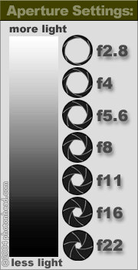
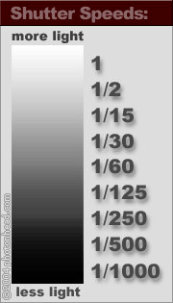

Slide 22
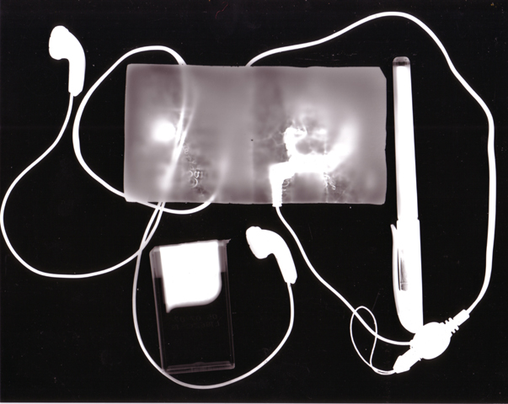
What is this ? How do you make one?

Slide 23
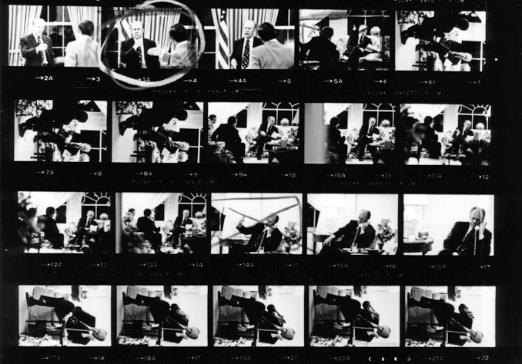
What is this ? How do you make one?

Slide 24
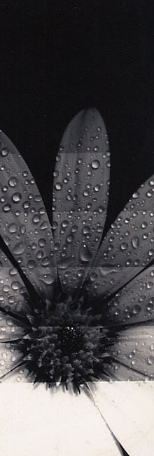
What is this? How do you make one? Why do you need one?

Slide 26
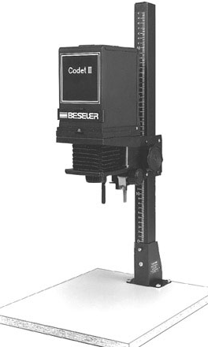
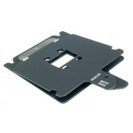
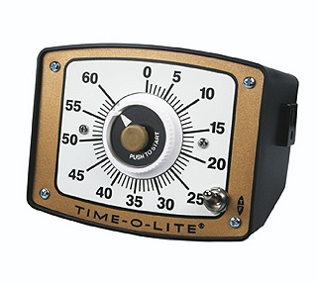
Draw arrows to the following parts Size adjusting knob Focusing knob Lens Aperture ring Timer Negative holder Where does the negative holder go? Where does the easel go?

Slide 27
where is the best placement for your main subject?

Slide 28
What do I use to figure out the aperture or shutter speed for each picture?
Answer is NOT the camera itself.

Slide 29
What should you put in the black light proof bag when getting ready to develop my film?

Slide 30
What is depth of field? List one factor that effects it.

Slide 31
Explain bracketing

Slide 32
Show me how to bracket on mock exposure sheet, first fstop then shutter speed
Subject | F-stop | Shutter speed

Slide 33
Why would you avoid using unnecessary fast shutter speeds? Think flinstones

Slide 34
How long do you expose a contact sheet for?

Slide 35
How long do you expose a text print for ? Why does it have stripes?

Slide 36
How do you use an easel?

Slide 37
What is a safelight?
What is a safe for?

Slide 38
What is a contact sheet?

Slide 39
Why do we agitate chemicals?

Slide 40
What type of camera do we use? Be specific

Slide 41
What does ASA refer to?

Slide 42
When do I use a fast film?
When do I use a slow film?
What numbers correlate with fast or slow film speeds?

Slide 43
What refers to the amount of time the light has to reach the film?

Slide 44
What refers to the size of the opening in which light travels?

Slide 45
What blocks light from film until the “button” is pressed?

Slide 46
Should it be light or dark when you are putting the film on the reel?

Slide 47
What is emulsion?
How can you tell where the emulsion is on the film?
On paper?

Slide 48
Tell me the steps of developing film.
Just list the liquid steps in order?

Slide 49
Tell me the steps of developing paper.
just list the liquid steps in order

Slide 50
Explain aperture, include a drawing labeled with numbers

Slide 51
Name six basic parts of the camera, things you must have to make an effective image!

Slide 52
Shutter speed and aperture work together to control….

Slide 53
At night or a dimly lit room…what aperture do I use?
What shutter speed would I use?

Slide 54
What does photo flo do for your film

Slide 55
What type of temperature should the water be when rinsing your film?

Slide 56
When do you need scissors for when developing film?
When making prints?

Slide 57
Until what step is your film and paper sensitive to light

Slide 58
What is the plug for?
what does the reel need to have? Why?

Slide 59
What is this?
How do you make one( do not include chemical steps) why do we make them?

Slide 60
What is this?
How do you make one? (do not include chemical steps) why do we make them?

Slide 61
What is this? How do you make one?

Slide 62
Make sure you know…. Aperture, negative holder, size adjusting knob, focus knob, lens

Slide 63
What is a light meter?

Slide 64
What does each chemical do?
Developer?
Stop bath
Fixer
Hypoclear
Photoflo
Which ones are film chemical and which ones are paper?

Slide 65
What is the different between shutter speed and aperture
What is Tv? What is Av?

Slide 66
Do you know all the words on your vocab list? Can you explain them all?
Burn in?
Dodge?
Cassette?
Contrast?
Value?
Exposure?
Film format?

