Slide 1
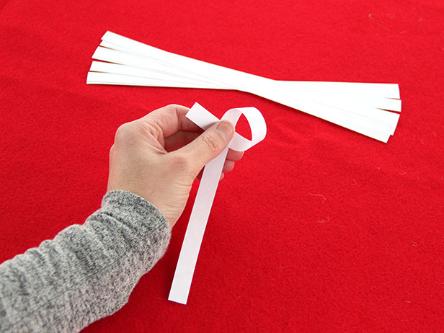
Cut strips of regular copy paper lengthwise, so that they’re 1/2 inch by 11 inches. Then the first step in folding is to create a small loop at one end.

Slide 2
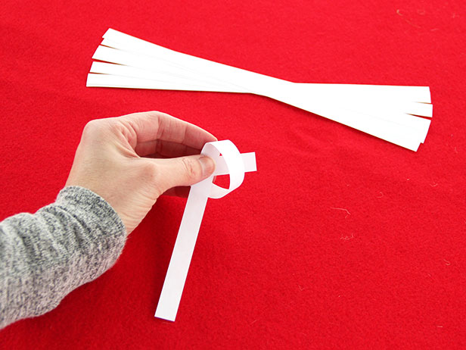
Feed the short end through the loop, as if you were going to tie a knot.

Slide 3
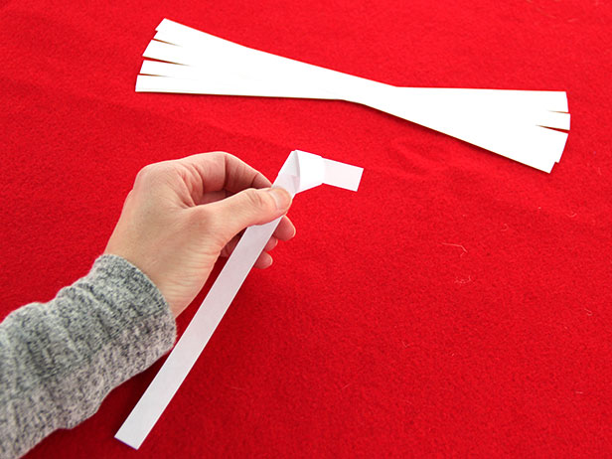
Gently tighten the knot, making sure that the short end stays pretty short.

Slide 4
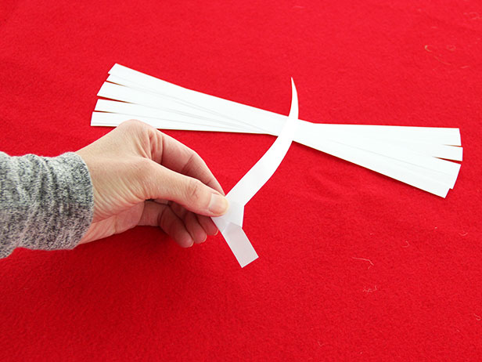
Turn the paper so the short end is at the bottom.

Slide 5
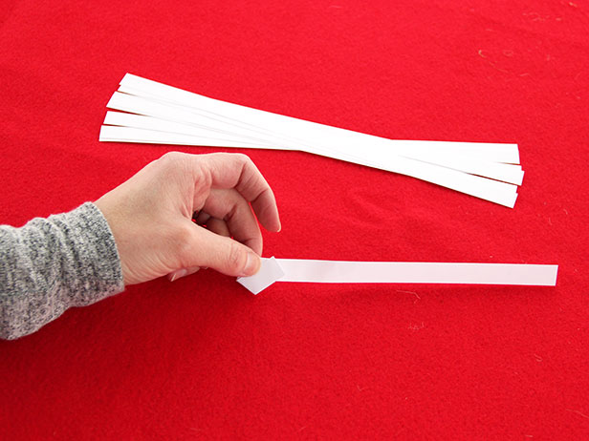
Fold the short end up and over the crossed paper.

Slide 6
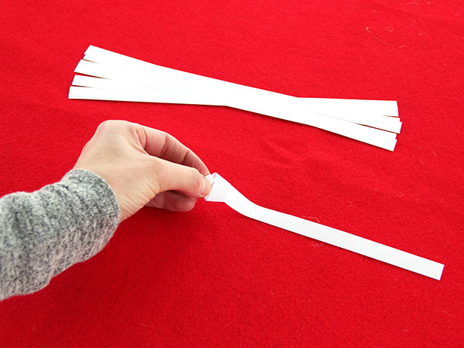
Now tuck the short end under the top layer of the crossed paper.

Slide 7
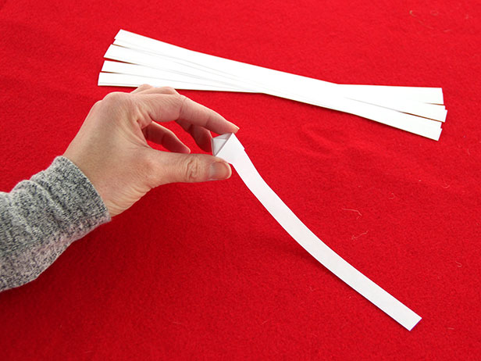
Now you have a pentagon with a tail. Which is cool in its own right, but wait…there’s more!

Slide 8
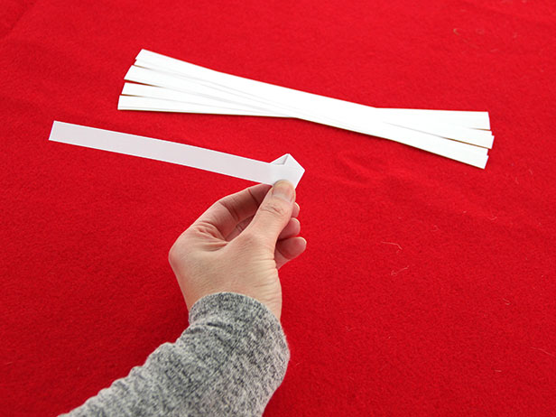
Fold the tail so that it wraps over where you just tucked in the short end, allowing the paper to fold to follow the shape of the pentagon.

Slide 9
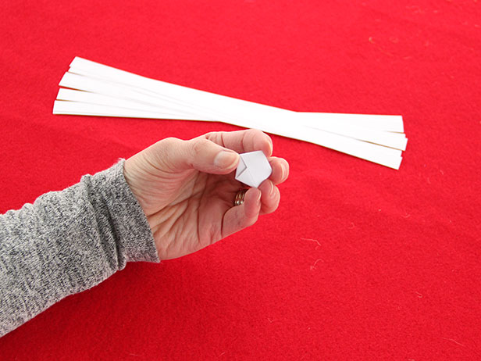
Continue to fold and wrap the tail around the pentagon. When you come to the end of the tail, tuck it into the fold in the same way that you tucked the short end in Step 6.

Slide 10
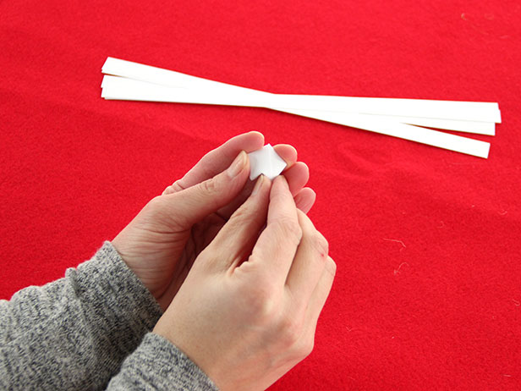
This is where your pentagon becomes a star. Use your fingernail to make an indent in the middle of one of the flat edges of the pentagon, and then continue around, indenting each side.

Slide 11
Done!

Slide 12
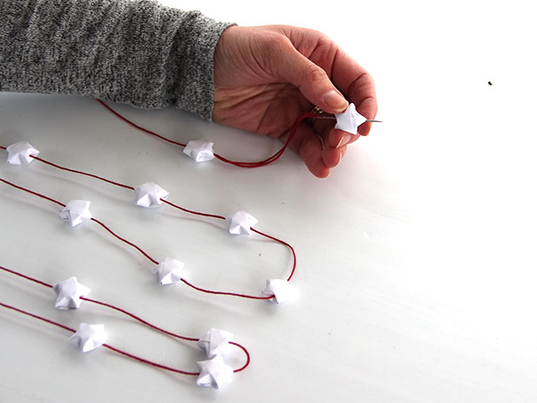
To make your stars into a garland, pierce the star through one of the indents so that the needle comes out of the top point. (This ensures the thread won’t pull the indent out and collapse the star.)

