Slide 1
Lies we have been told… and why we believe them.

Slide 2
Ben Franklin Discovered Electricity
Benjamin Franklin did not discover electricity when his kite was struck by lightning in 1752. In fact, electricity was already well known at the time. Instead, Franklin was trying to prove the electrical nature of lightning.

Slide 3
So if he didn’t do that… then what?
During a thunderstorm, as Franklin flew a silk kite with a metal key near the end of the string, he noticed the fibers on the line standing up as though charged.
He touched the key and felt a charge from the accumulated electricity in the air, not from a lightning strike. This was enough evidence to prove his theory that lightning was electricity.
Had the kite been struck by lightning, Franklin would likely have been killed as was Professor Georg Wilhelm Richmann of St. Petersburg, Russia, when he attempted the same experiment a few months later.

Slide 4
The Nina, The Pinta and The Santa Maria?

Slide 5
False.
The Nina was actually the Santa Clara.
The Pinta was a nickname, the actual name has been lost to history.
The Santa Maria was the name of the third ship.

Slide 6
So…
If our Elementary School Teachers lied to us, how are we to believe anyone or anything?
Why were these facts “changed”?
Is there any way to actually find the truth?

Slide 7
When the truth cannot be accepted.

Slide 8
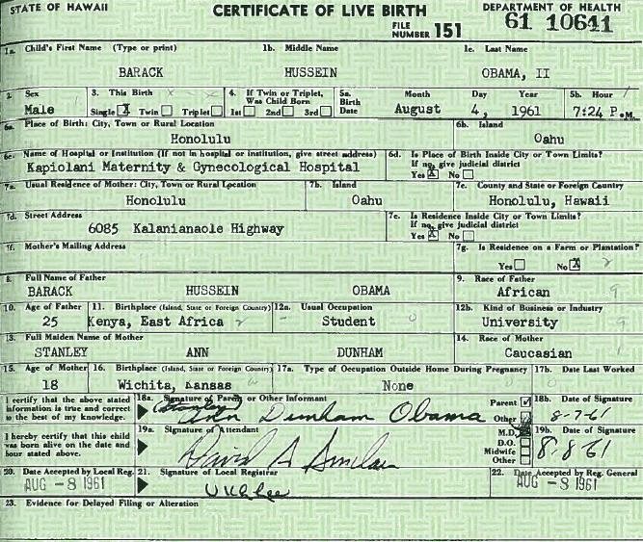
The President’s Birth Certificate

Slide 9
When the truth appears to be false.

Slide 10
Clinton/Lewinsky Affair
In January 1998, citizen journalist Matt Drudge reported a sensational story tha­t turned out to be true. The president of the United States, Bill Clinton, had an affair with a White House intern, Monica Lewinsky. As suspicions mounted, Clinton publicly denied the allegations. As if this lie weren't big enough, it turned out that Clinton had lied under oath about the affair as well -- which was perjury and grounds for impeachment.

Slide 11
Who do we believe?
Why do we believe the Media?
What Media outlets do we tend to believe more than others?
How can we tell if anything is authentic anymore?

Slide 12
Catfish
On a singular sheet of paper, you will answer the following prompt, once we have finished viewing the story:
With today’s media and manipulation, how are we able to control the truth?
You will want to write two paragraphs, of at least five sentences each, with references to the video and other media elements.
Think: 1. How can we manipulate the media? 2. How can we prevent this from happening to us?

Slide 13
How do we manipulate the Media for our own Benefit?
The uses of Social Media, Online Databases and Apps.
We may choose our news and what we view. We have the poor to instantly edit.
Technology allows us to manipulate our identities and create our own existence.
CATFISH.

Slide 14
How does the Media manipulate us? Why?
News is decided by what people are clicking, not by what is the “most important”.
The more people that view something, the more incentive the media has to claim its truth.
The Media relies on us to pass their stories on via social media and sharing.
SEARCH ENGINES. CLICK SHARE.

Slide 15
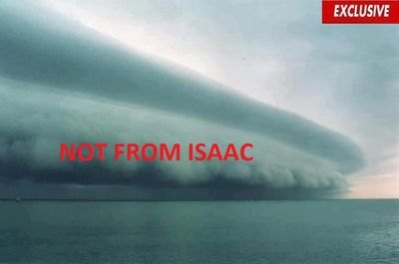
How does the Media manipulate us? Why?

Slide 16
Media Manipulation
News is produced so quickly, that it is often incomplete.
Blogs rule the news media… which shows a problem with Sources.
The Government feeds media what it wants, not what it has.
When we don’t pay for media, the media doesn’t feel the need to be 100%.

